Slide 1

FINAL SEMESTER PRESENTATION
Integrated Cyber Defense Environment (ICDE)
By: Sudarshan Rangappa 012300300008002019 Msc. Cyber Security
Under the Guidance of: Dr. Ramya Shah Assistant Professor
Submitted To: School of Cybersecurity and Digitial Forensics
National Forensic Sciences University

Slide 2



Table Of Contents
1. Introduction
2. Problem Statement
3. Objectives
4. Scope of Project
5. Literature Review
6. Tools and Technologies Used
7. System Architecture
8. Implementation
9. Testing & Output (Key Scenarios)
10. Limitation Of project

Slide 3


Introduction
The Evolving Threat Landscape: Increasing sophistication, persistence, and automation of cyber threats.
Modern Security Operations Centers (SOCs): Central hubs for monitoring, detection, analysis, and response.
The Need for Integration: Siloed tools lead to alert fatigue, slow response, and missed correlations.
What is an ICDE? An integrated ecosystem where security tools (SIEM, SOAR, NIDS, HIDS, etc.) work synergistically.
Why Build This ICDE? To create a realistic, hands-on virtual lab for training, testing, and validating defensive strategies without impacting production systems.

Slide 4
Problem Statement
Challenge: Difficulty for organizations/institutions to establish effective, affordable, and comprehensive cybersecurity training/testing environments.
Cost Barrier: Commercial solutions are often expensive.
Integration Complexity: Integrating diverse open-source tools requires significant expertise and effort.
The Gap: Need for a well-documented, functional, and accessible virtual lab environment based on readily available tools to bridge the skills gap.

Slide 5
Objectives
Primary Goal: Build, deploy, and test a virtualized ICDE simulating key SOC functions.
Specific Objectives:
Develop a scalable VMware-based framework.
Install & configure core security tools (Wazuh, Shuffle, Suricata, OpenVAS, Cowrie, Splunk).
Integrate tools for effective data exchange (logs, alerts).
Establish a realistic target environment (Active Directory, Endpoints).
Configure Shuffle (SOAR) for alert ingestion and basic automation.
Demonstrate detection and management of simulated attacks.
Validate the integrated stack using Kali Linux.

Slide 6
Scope of Project
In Scope:
Design and implementation of the virtualized environment in VMware.
Installation and configuration of specified security tools.
Setup of Active Directory domain (home.lab), Windows Server 2025 DC, and Windows 11 endpoint.
Initial integration for data flow (log forwarding, alert webhooks).
Demonstration of core functionalities: alert generation, log collection, vulnerability scanning, honeypot interaction, alert ingestion into Shuffle.
Basic validation using simulated attacks from Kali Linux.

Slide 7
Scope of Project
Out of Scope:
Exhaustive performance benchmarking under heavy load.
Development of complex, fully automated end-to-end response playbooks in Shuffle (designated as future work).
Large-scale environment simulation (limited by hardware resources).

Slide 8
Literature Review
Title | Key Findings | Limitation
Stallings, W. (2020). Cybersecurity Technologies for Network Defense: SIEM Solutions | SIEM plays a critical role in real-time threat detection through log aggregation and correlation. | SIEM solutions generate high volumes of alerts, often leading to alert fatigue.
Shackleford, D. (2019). SOAR: The Future of Automated Incident Response. | SOAR improves response times by automating incident workflows. | Integration challenges with legacy security infrastructure limit its effectiveness.
Spitzner, L. (2018). Honeypots: Tracking Hackers. | Honeypots are effective in gathering intelligence on attacker behavior and tactics. | They require continuous monitoring and maintenance to avoid detection by attackers.
Paxson, V. (2021). Network Monitoring with Zeek: A Deep Dive into Intrusion Detection | Zeek provides deep packet inspection and enriches threat intelligence. | High-performance overhead and storage requirements for large network environments.
Herzog, A. (2022). OpenVAS and Vulnerability Management in Modern Cybersecurity Frameworks. | OpenVAS efficiently scans for vulnerabilities and provides remediation suggestions. | High false-positive rates lead to unnecessary resource allocation.

Slide 9
Tools and Technologies Used
Virtualization: VMware Workstation
SIEM/HIDS: Wazuh (Manager, Indexer, Dashboard, Agents)
SOAR: Shuffle (Open-Source SOAR Platform)
NIDS: Suricata
Vulnerability Scanner: OpenVAS (Greenbone Vulnerability Management - GVM)
Honeypot: Cowrie (SSH/Telnet Honeypot)

Slide 10
Tools and Technologies Used
Log Aggregation/Analysis: Splunk Enterprise (Free License)
Target Environment:
Windows Server 2025 (Active Directory Domain Controller)
Windows 11 (Endpoint)
Sysmon (Enhanced Endpoint Monitoring)
Attacker Machine: Kali Linux
Operating Systems: Ubuntu Server 22.04 LTS, Debian 12, Windows

Slide 11
System Architecture - Network Topology
Environment: VMware Workstation
Network: ICDE-project [NAT network] {192.168.33.0/24}
VM List & IPs:
Kali (Attacker): 192.168.33.143
Splunk (Log Aggregation): 192.168.33.128
Win Server 2025 (AD DC): 192.168.33.129
Win 11 (Endpoint): 192.168.33.130
Wazuh Manager: 192.168.33.131
Shuffle (SOAR): 192.168.33.149
OpenVAS (Scanner): 192.168.33.147
Cowrie (Honeypot): 192.168.33.142
Suricata (NIDS): 192.168.33.144

Slide 12
Role / Primary Tool | Operating System | IP Address | RAM | vCPUs | Hard Disk | Notes
Attacker Machine | Kali Linux | 192.168.33.143/24 | 4gb | 2 | 80gb | Used for launching simulated attacks.
Log Aggregation / Analysis | Ubuntu Server 22.04 LTS | 192.168.33.128/24 | 4gb | 2 | 80gb | Hosts Splunk Enterprise (Free License).
Domain Controller / AD | Windows Server 2025 | 192.168.33.129/24 | 4gb | 4 | 60gb | Hosts Active Directory Domain Services.
Target Endpoint | Windows 11 | 192.168.33.130/24 | 4gb | 2 | 80gb | Represents a typical user workstation.
SIEM / HIDS Manager | Ubuntu Server 22.04 LTS | 192.168.33.131/24 | 4gb | 2 | 80gb | Hosts Wazuh Manager.
SOAR Platform | Ubuntu Server 22.04 LTS | 192.168.33.149/24 | 8gb | 2 | 60gb | Hosts Shuffle.
Vulnerability Scanner | Debian 12 | 192.168.33.147/24 | 8gb | 4 | 60gb | Hosts OpenVAS (GVM).
Honeypot | Debian 12 | 192.168.33.142/24 | 4gb | 2 | 60gb | Hosts Cowrie.
NIDS Sensor | Debian 12 | 192.168.33.144/24 | 2gb | 2 | 60gb | Hosts Suricata. (May need promiscuous mode)
System Architecture Network Topology

Slide 13
System Architecture - Component Roles & Integration
Wazuh: Collects endpoint/server logs, performs HIDS, correlates events, generates alerts. Forwards alerts/logs to Splunk & Shuffle.
Suricata: Monitors network traffic (NIDS), generates alerts (Eve JSON). Logs collected by Wazuh agent.
Cowrie: Captures SSH/Telnet interaction attempts. Logs collected by Wazuh agent.
OpenVAS: Performs vulnerability scans on targets. Results viewed via GSA.
Splunk: Central log repository (Wazuh, Suricata, Cowrie via Wazuh). Enables deep search and analysis.
Shuffle: Ingests Wazuh alerts via webhook. Orchestrates basic notification (Telegram). Foundation for future automation.
AD/Endpoints: Realistic target environment generating logs (enhanced via GPO/Sysmon). Monitored by Wazuh agents.
Kali: Simulates attacks to test detection and response.
Integration: Primarily via Wazuh Agents, Splunk Universal Forwarder (Wazuh -> Splunk), and Webhooks (Wazuh -> Shuffle).

Slide 14
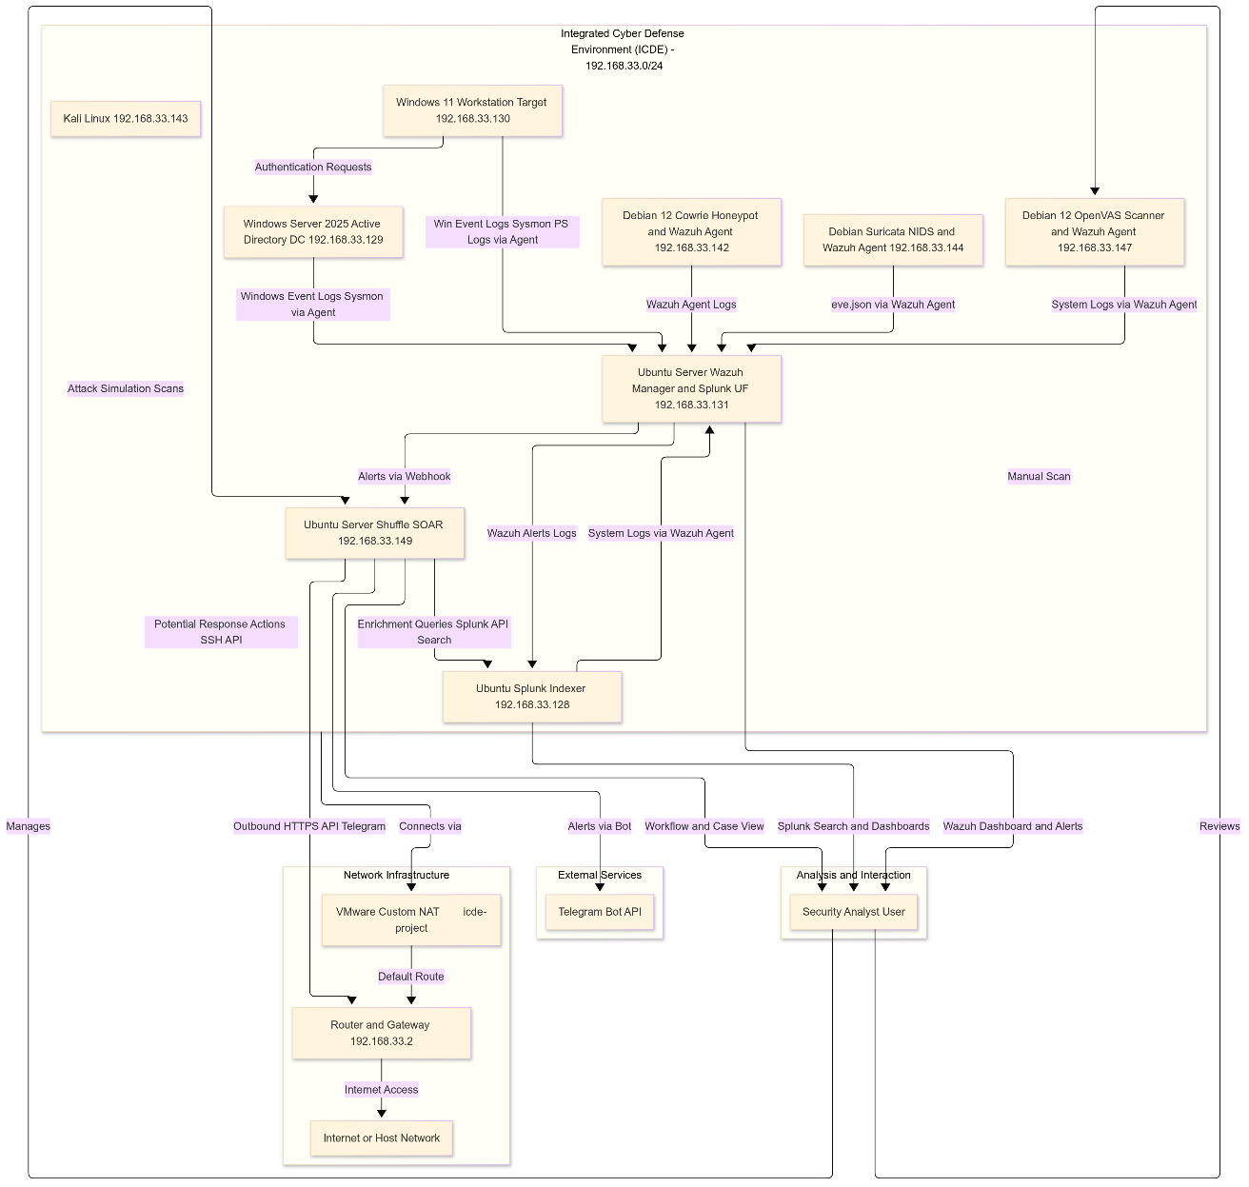
System Architecture - Component Roles & Integration

Slide 15
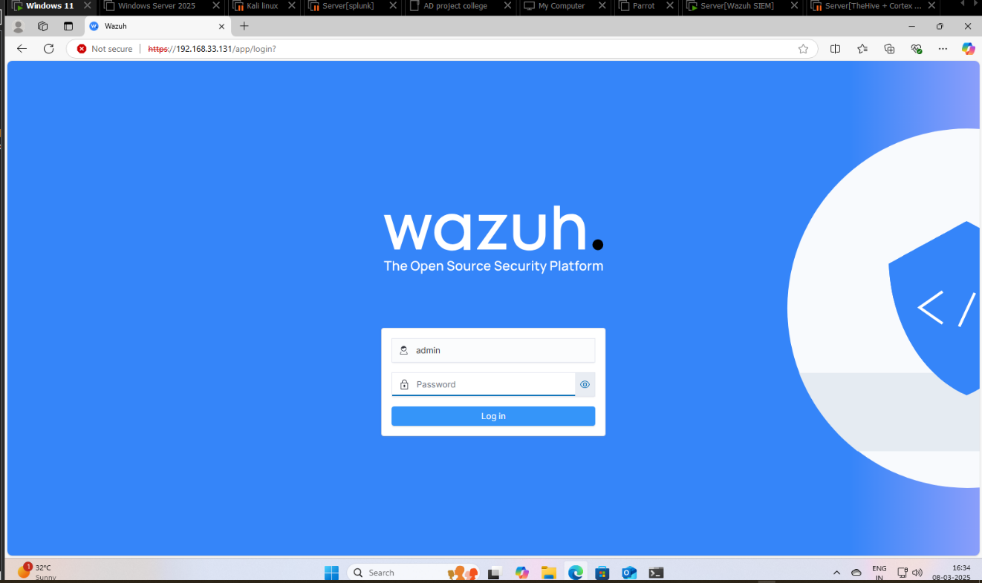
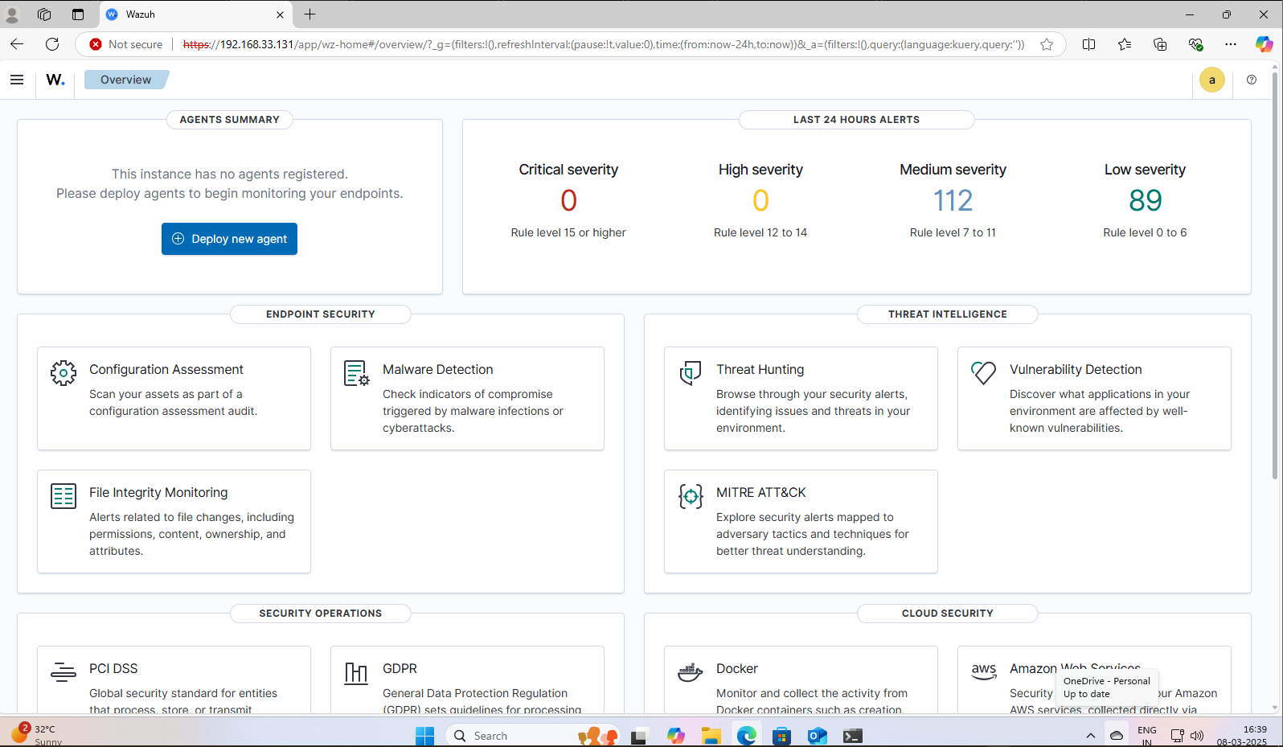
Implementation - Wazuh & Agents
Wazuh Server: Installed using assisted installation script on Ubuntu.

Slide 16

Implementation
Wazuh agents on Windows machines & Linux machines ,Log forwarding to splunk, Suricata[NIDS], OpenVAS [vulnerability Assessment] , Cowrie [honeypot], Splunk[Log Aggregation], AD & Endpoints, Shuffle [SOAR]

Slide 17
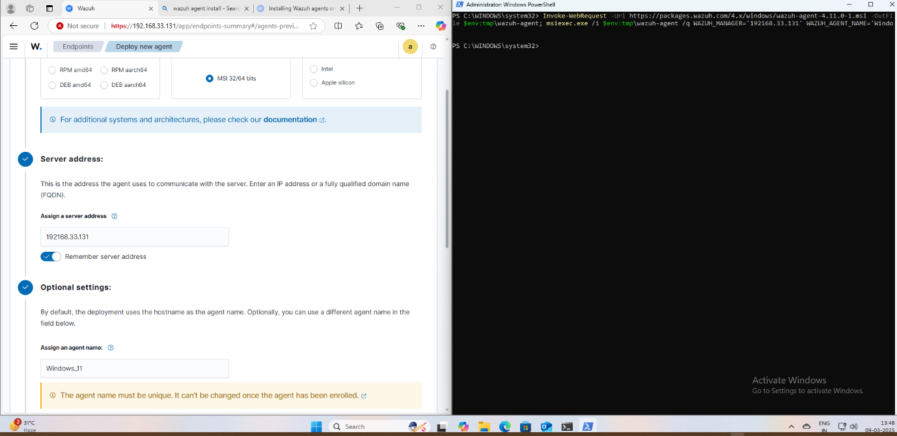
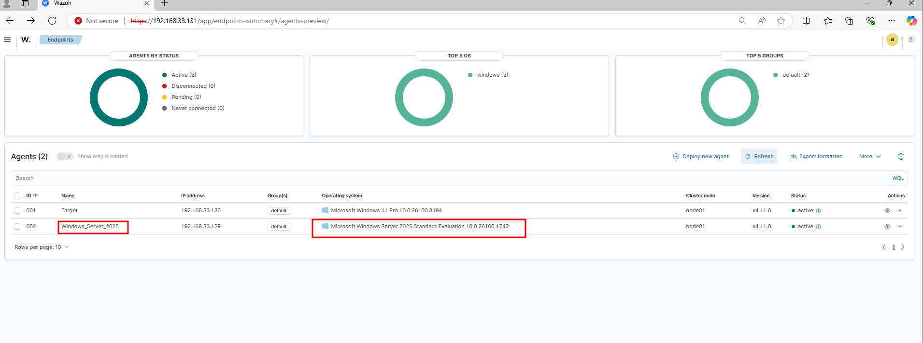
Implementation – Wazuh Agents on windows
Agent Deployment: Using Wazuh UI "Deploy new agent" feature.
Windows Agents (Server 2025, Win 11): PowerShell commands executed.

Slide 18
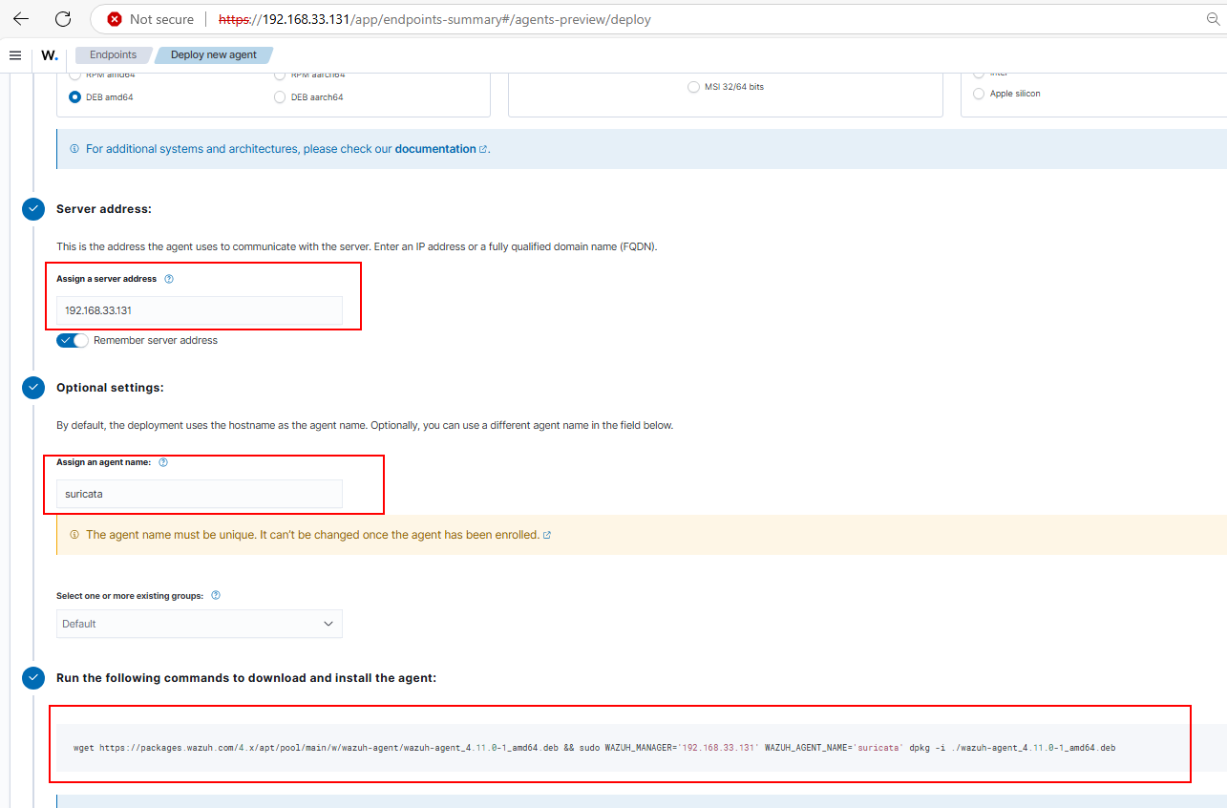
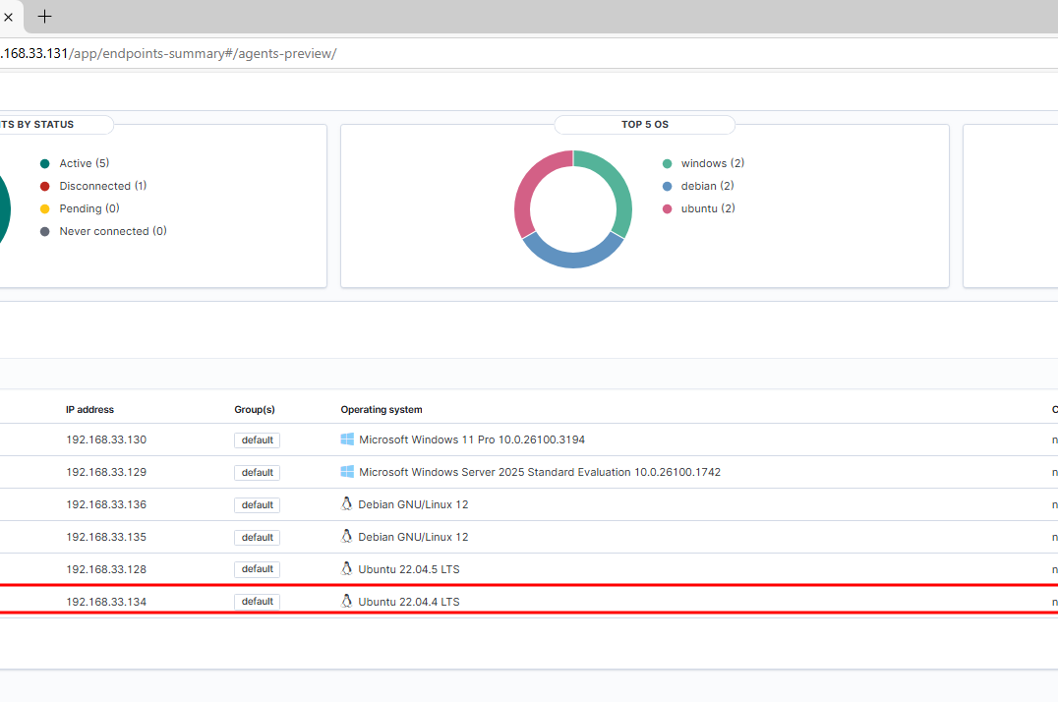
Implementation – Agents On Linux
Linux Agents (Suricata, Cowrie, Splunk, OpenVAS): Command-line deployment.

Slide 19
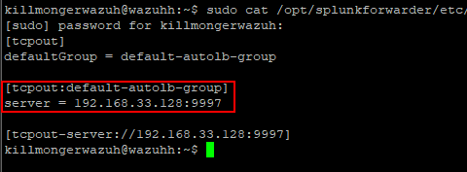
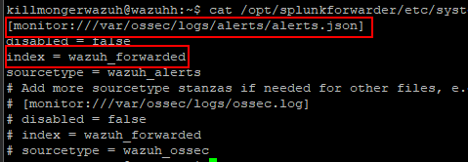
Implementation
Log Forwarding to Splunk: Splunk Universal Forwarder on Wazuh Manager monitoring alerts.json.

Slide 20
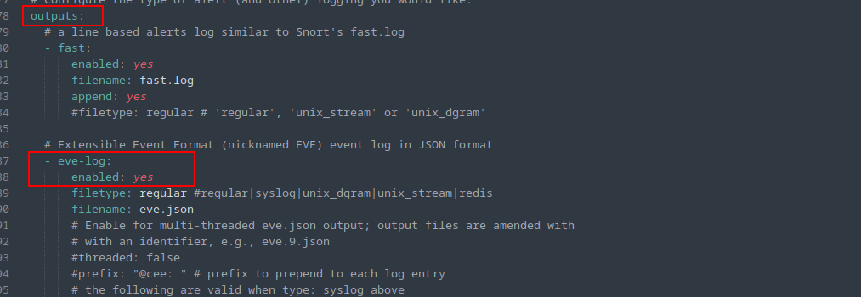
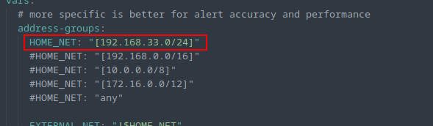
Implementation - Suricata (NIDS)
Installation: Standard apt install suricata on Debian.
Configuration (suricata.yaml):
Set HOME_NET to 192.168.33.0/24.
Configured af-packet interface (e.g., ens192).
Enabled Eve JSON logging (eve.json).
Updated rulesets (suricata-update).

Slide 21
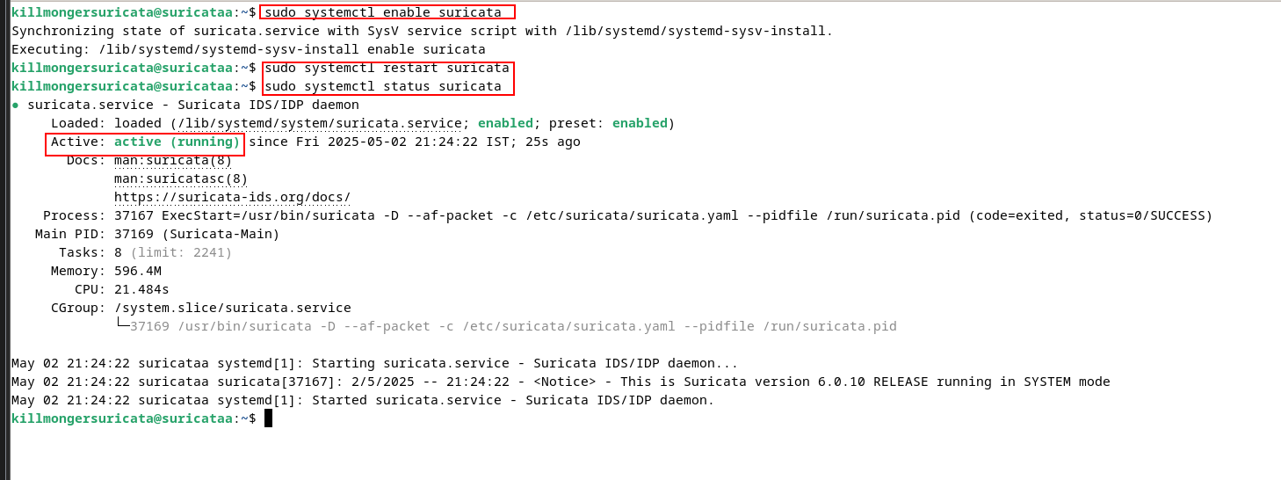
Implementation - Suricata (NIDS)
Service: Enabled and started suricata.service.
Integration: Logs monitored by local Wazuh agent.

Slide 22
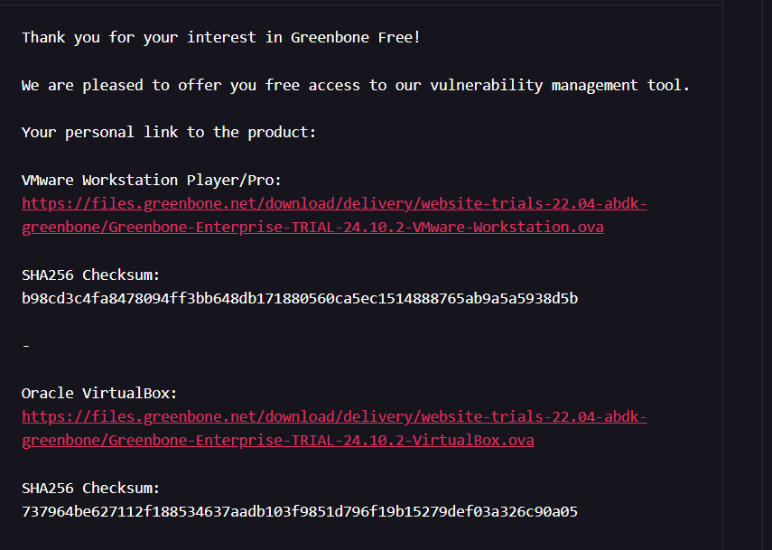
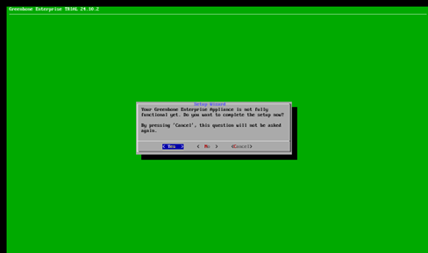
Implementation - OpenVAS (Vulnerability Scanner)
Deployment: Downloaded OVA file from Official Greenbone Site & Imported Greenbone Community Edition OVA into VMware.
Setup: Initial wizard for admin user creation.

Slide 23
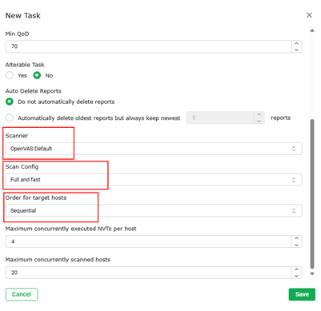
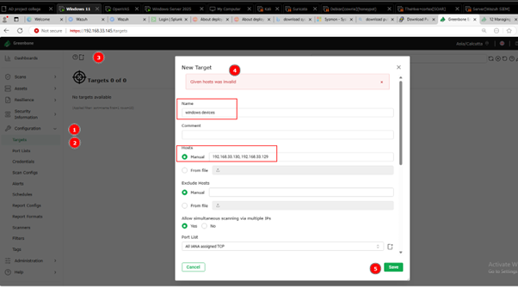
Implementation - OpenVAS (Vulnerability Scanner)
Feed Sync: Automatic synchronization of NVT/SCAP/CERT data. Configuration:
Defined target IPs (Win Server, Win 11) in GSA.
Created and ran scan tasks ("Full and fast").

Slide 24

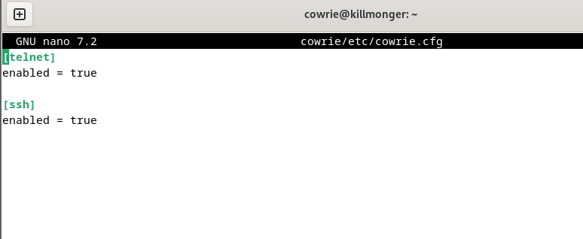
Implementation - Cowrie (Honeypot)
Installation: Followed official documentation (dependencies, git clone, venv).
Configuration (cowrie.cfg):
Set realistic hostname.
Enabled SSH (port 2222) and Telnet listeners.

Slide 25
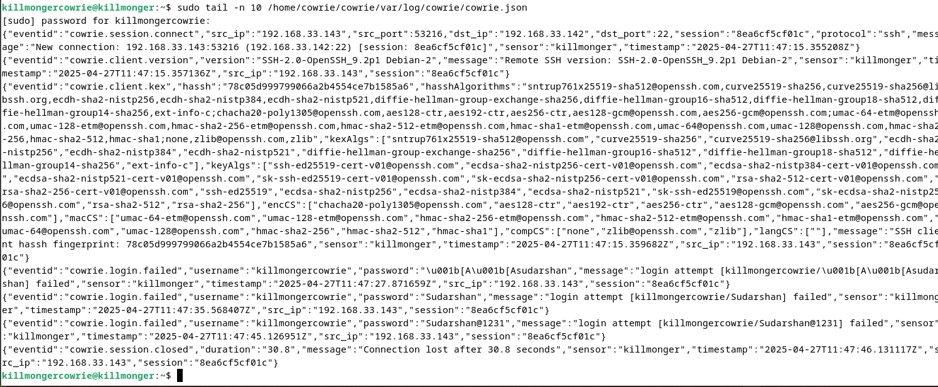
Implementation - Cowrie (Honeypot)
Service: Started using cowrie start (or configured as a service).
Integration: Logs (cowrie.json) monitored by local Wazuh agent.
Testing: SSH attempts from Kali captured.

Slide 26
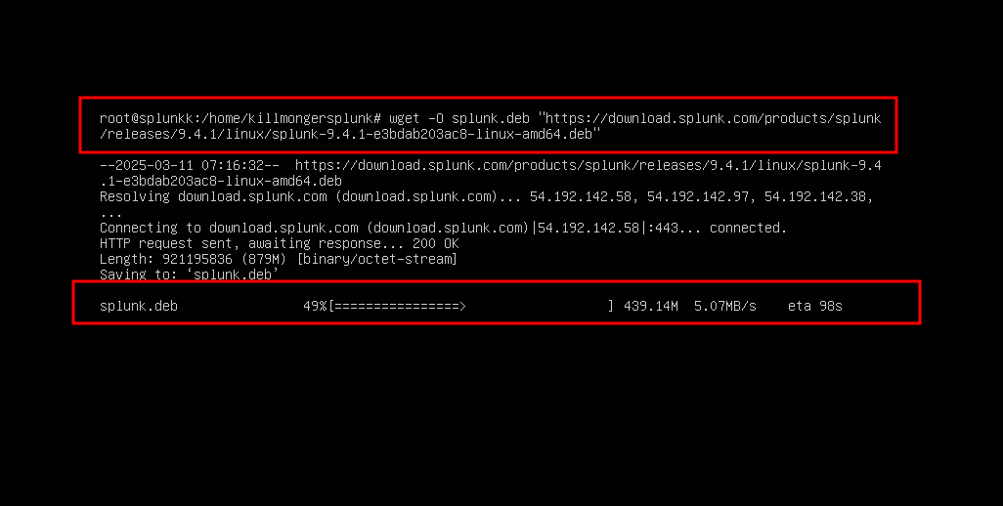
Implementation - Splunk (Log Aggregation)
Installation: dpkg -i splunk*.deb on Ubuntu. Initial setup via CLI.

Slide 27
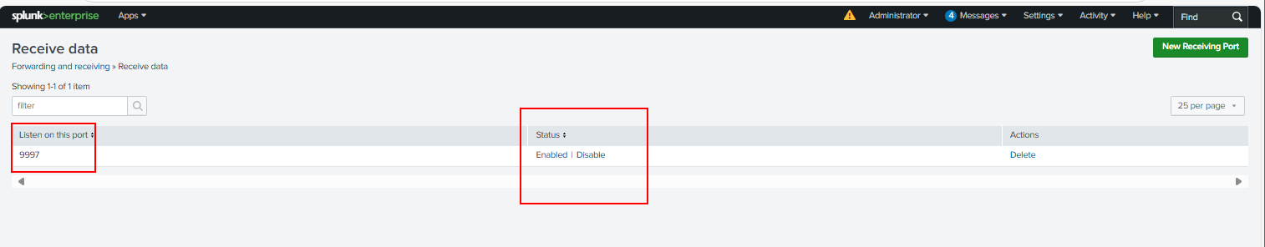
Implementation - Splunk (Log Aggregation)
Configuration:
Enabled TCP input on port 9997 for Universal Forwarder data.

Slide 28
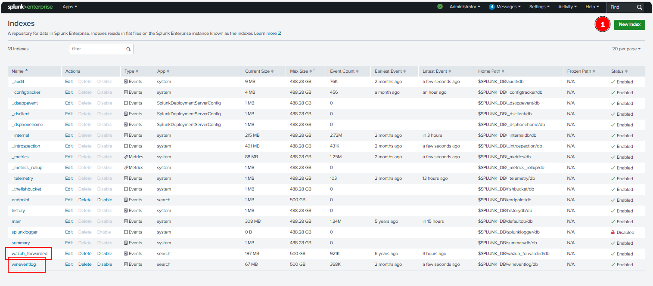
Implementation - Splunk (Log Aggregation)
Created custom indexes (wineventlog, wazuh_forwarded).

Slide 29
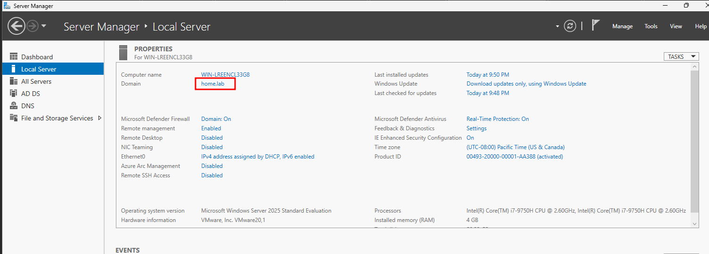
Implementation - Active Directory & Endpoints
AD Setup: Windows Server 2025 promoted to DC for home.lab domain.

Slide 30
Implementation - Active Directory & Endpoints
OU Name | Groups Inside OU | Users Inside OU | Group Memberships
IT | IT Admins | AdminUser | AdminUser → IT Admins, Domain Users
Finance | Finance Team | FinanceUser | FinanceUser → Finance Team, Domain Users
Security | Security Analysts, Log Readers | SecurityAnalyst | SecurityAnalyst → Security Analysts, Log Readers, Domain Users
GeneralUsers | Remote Access Users | Bob, Alice | Bob, Alice → Remote Access Users, Domain Users
Workstations | (No groups, just stores computers) | Windows 11 client | (N/A)
Servers | (No groups, just stores servers) | Windows Server, Wazuh, TheHive, Splunk, OpenVAS, Cowrie, Zeek | (N/A)
Structure: Created OUs (IT, Finance, Security, etc.), Users (AdminUser, Bob, etc.), and Groups.

Slide 31
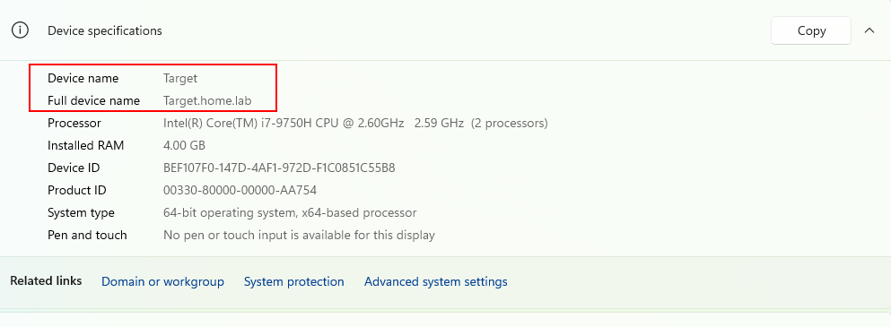
Implementation - Active Directory & Endpoints
Endpoint: Windows 11 joined to home.lab domain.

Slide 32
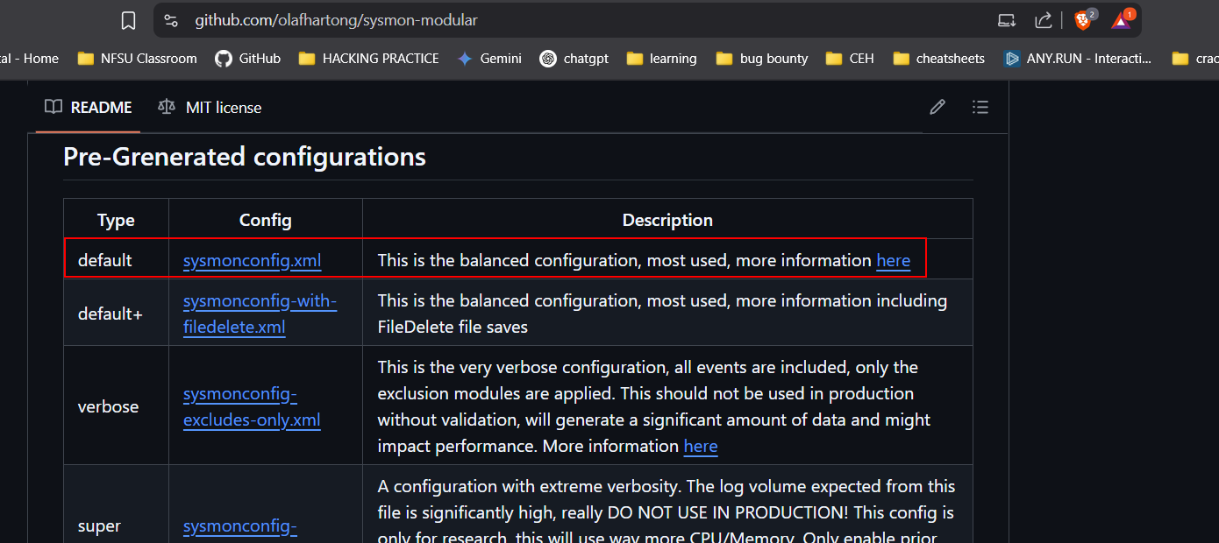
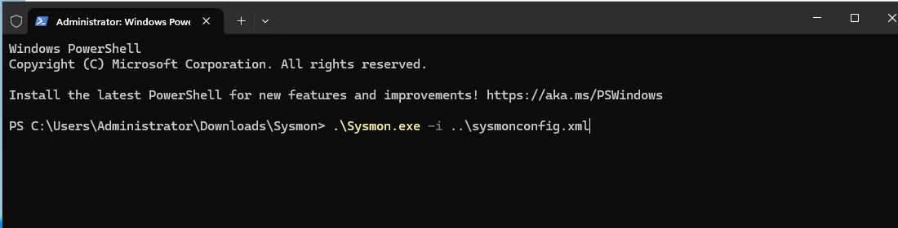
Implementation - Active Directory & Endpoints
Sysmon: Installed with Olaf Hartong's config (sysmonconfig.xml).

Slide 33
Implementation - Shuffle (SOAR)
Installation: Deployed using Docker Compose on Ubuntu.

Slide 34
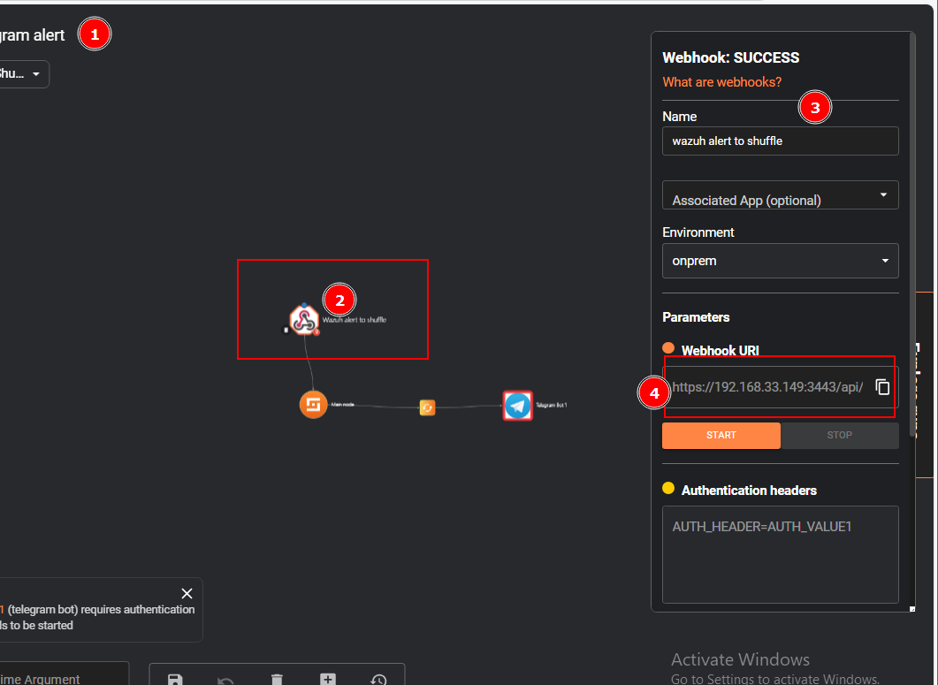
Implementation - Shuffle (SOAR)
Integration with Wazuh:
Created Webhook listener in Shuffle.

Slide 35
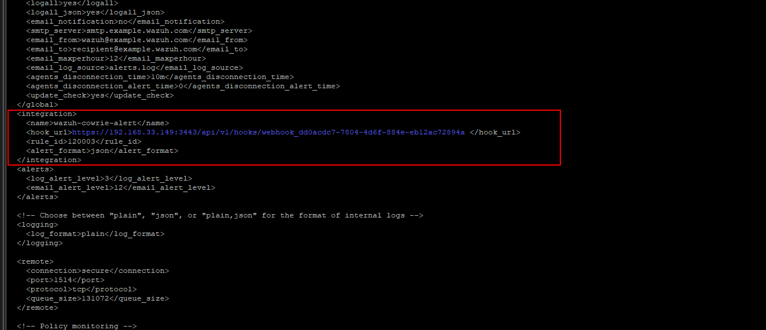
Implementation - Shuffle (SOAR)
Configured Wazuh ossec.conf to send alerts to Shuffle webhook URL.

Slide 36
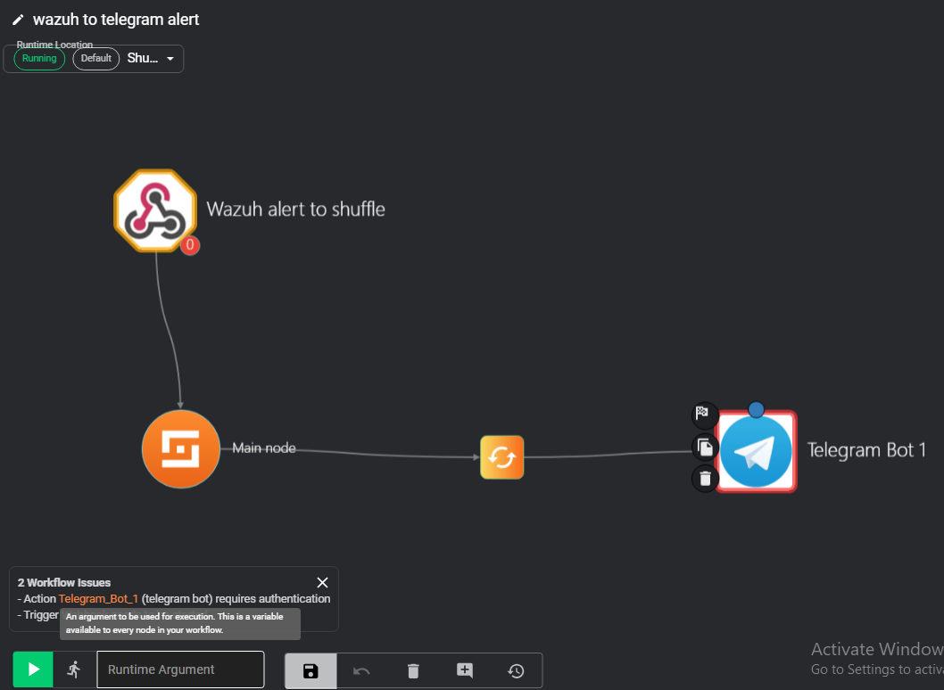
Implementation - Shuffle (SOAR)
Basic Workflow:
Configured Telegram App for notifications.
Simple workflow: Webhook Trigger -> Telegram Send Message.

Slide 37
Testing & Output
Honeypot Interaction & SOAR

Slide 38
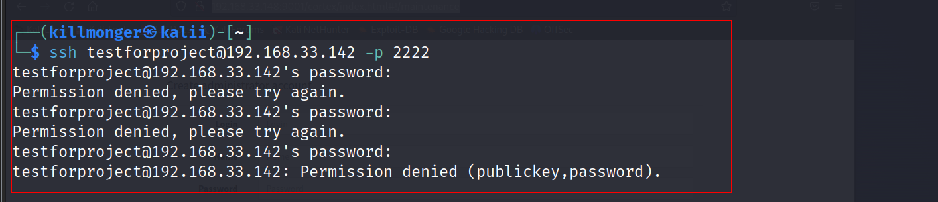
Testing & Output
Scenario: SSH brute-force attempt from Kali to Cowrie (port 2222).

Slide 39
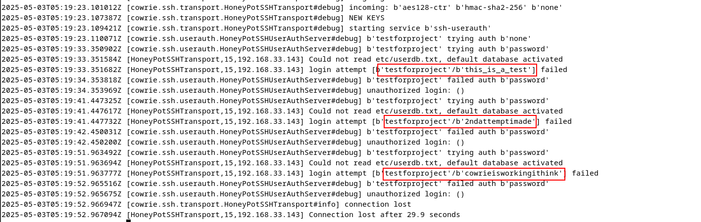
Testing & Output
Detection:
Cowrie logged the attempt.

Slide 40
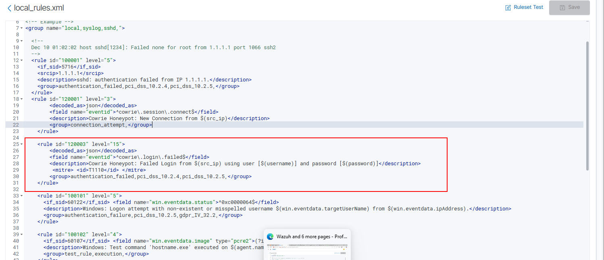
Testing & Output
Wazuh agent sent log to Manager.
Wazuh generated high-severity alert (Rule 120003).

Slide 41
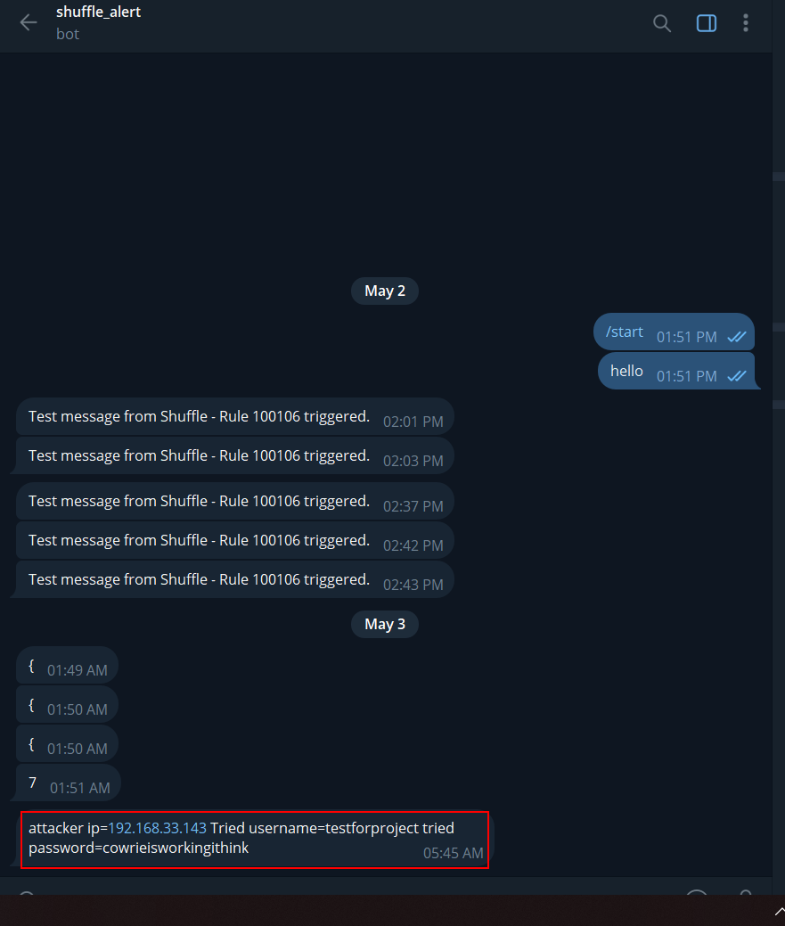
Testing & Output
Automation:
Wazuh sent alert via webhook to Shuffle.
Shuffle workflow triggered.
Telegram notification sent to analyst.

Slide 42

Limitations of the Project
Focus on Integration & Configuration: The primary focus was setting up and connecting the tools, not deep performance optimization or advanced feature utilization.
Limited SOAR Automation: Development of complex, automated response playbooks in Shuffle was outside the defined scope (future work). Only basic alert ingestion and notification were implemented.
Hardware Constraints: The scale of the environment (number of endpoints, AD complexity, simulation intensity) was limited by the physical resources of the host machine.
No Heavy Load Testing: Performance under sustained, high-volume attack scenarios was not formally benchmarked.

Slide 43
thank you

